Slide 1
Influenza A Subtyping Assay
HOLOGIC PANTHER FUSION ASSAY
Whitney Platte
May 2nd, 2026

Slide 2
Design Process and Implementation
Target Selection
Primer and Probe Strategy
Singleplex vs Multiplex
Initial Assay Design
Proof of Concept
Optimization of Primer/Probe Mix
Assay Validation
Outcome

Slide 3




Target Selection
H3
pdmA
pdmH1
H5a
Added later due to emerging surveillance needs
Notes:
Download the full brand icon set at brand.uiowa.edu/graphic-elements

Slide 4
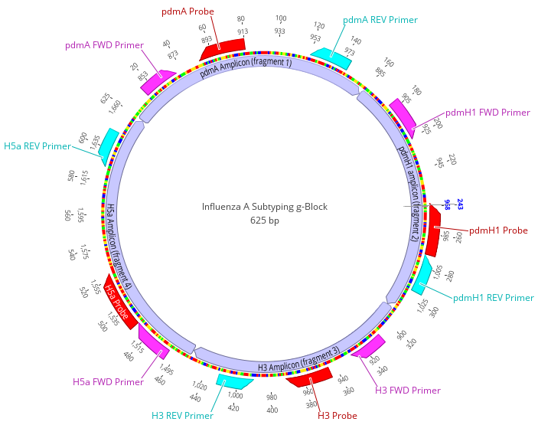
Primer / Probe Strategy and Decision
Decision
  Use current CDC primers and probes
Reasoning
  Maintain alignment with CDC protocols
    Reduce the need for continuous updates
  Avoid dedicating additional SHL time and resources to primer/probe redesign
    Present and future updates
  Align assay as close as possible with CDC labeling as possible

Slide 5
Decision to use Singleplex Assay Design
Singleplex
Multiplex
Limited validation timeline
  ~ 1 Month
Reduced technical complexity and validation timeline
Assign all 4 subtypes or any combination of the 4 per sample
Requires design and optimization of new primer/probe combinations
  CDC uses Singleplex primers/probes
Consultation with IDT
  Primer-dimer interactions can occur with some of the targets when multiplexed

Slide 6





Initial Assay Design – Panther Fusion Open Access
1st Draft in Open Access
Upload assay to Panther Fusion Instrument
Thermal Profile Development
Constraints
Adjustment
Notes:
Download the full brand icon set at brand.uiowa.edu/graphic-elements

Slide 7
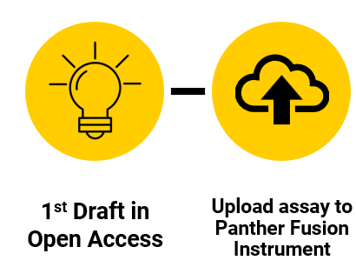
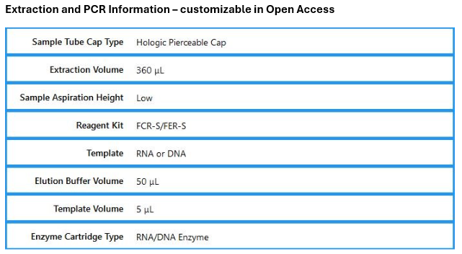
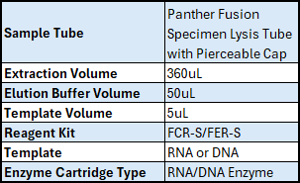
Used Hologic Fusion Specimen Lysis Tubes
Reflex positive specimens from Panther Fusion SARS-CoV-2/Flu A/B/RSV IVD assay
  Enough volume to retest 1 time
Must choose all tests needed upfront to run off 1 extraction
Controls
  Positivity Threshold set to 300
  G-Block for Positive control
  Hologic’s Internal Control
    Make sure to make IC valid if any channel is positive,
    Sometimes get out-competed by positive sample

Slide 8
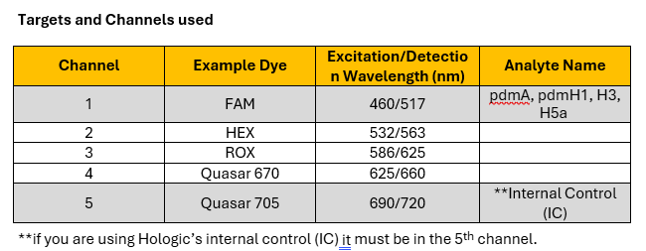

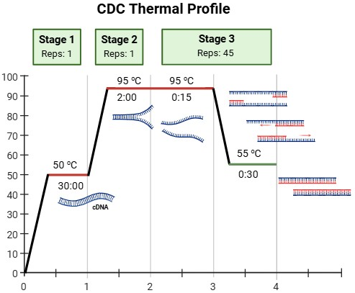
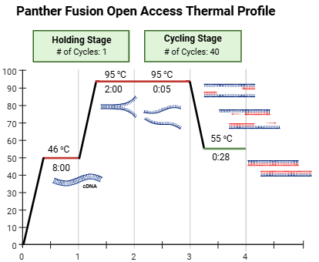
Singleplex assay allows us to use the same channel for each analyte
Fam is a bright reporter dye
Goal: Match CDC thermal profile as closely as possible

Slide 9


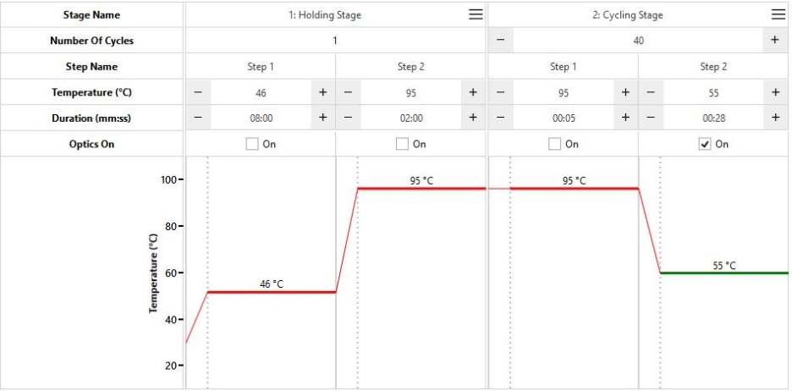
Panther Fusion runtime cannot exceed 55 minutes
Reduced PCR cycles from 45 → 40 cycles
Shortened these steps on the Panther Fusion Assay
  Step 1 of the Holding Stage
  Step 1 of the Cycling Stage
  Step 2 of the Cycling Stage
Lowered the Threshold after Go-Live due to weak amplification of pdm A
100% of Flu A positive specimens with a ct of 34 or less are subtyped

Slide 10
Proof of Concept
Performed initial testing using the CDC primers and probes
  H3/pdmA/pdmH1
  H5a (separate following validation)
Purpose
  Confirm target amplification
  Verify assay compatibility with the Panther Fusion platform

Slide 11
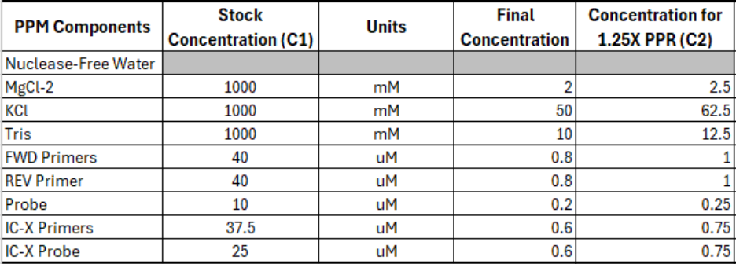
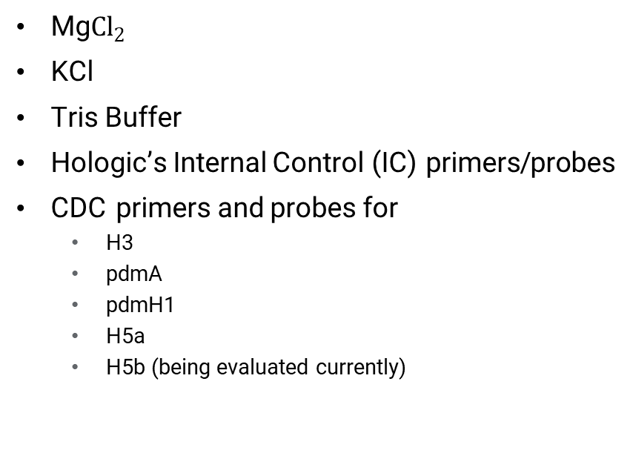
Optimization of Primer/Probe Mix (PPM)
Components Evaluated
Goal
Mg${Cl}_{2}$
KCl
Tris Buffer
Hologic’s Internal Control (IC) primers/probes
CDC primers and probes for
  H3
  pdmA
  pdmH1
  H5a
  H5b (being evaluated currently)
Determine optimal stock and final concentrations to ensure
  Efficient amplification
  Balanced reaction conditions
  Reliable internal control detection

Slide 12

Formal Validation after Assay Conditions Finalized
H3/pdmA/pdmH1
%
Limit of Detection (LOD)
PCR Efficiency 90-110%
Accuracy
Precision
H3 – 100%
pdmA – 93.8%
pdmH1 – 98.4%
H3 – 100%
pdmA – 92.2%
pdmH1 – 98.4%
H3 – 4.5 copies/uL
pdmA – 15 copies/uL
pdmH1 – 4.5 copies/uL
H3 – 101.2%
pdmA – 101.94%
pdmH1 – 96.5%

Slide 13
Formal Validation after Assay Conditions Finalized
H5
%
Accuracy
Precision
Limit of Detection (LOD)
PCR Efficiency 90-110%
100%
100%
4.5 copies/uL
93.4%

Slide 14
Outcome
Successful validation and implementation of Influenza A subtyping assays on the Panther Fusion platform.
Assay is live with no performance issues.

Slide 15
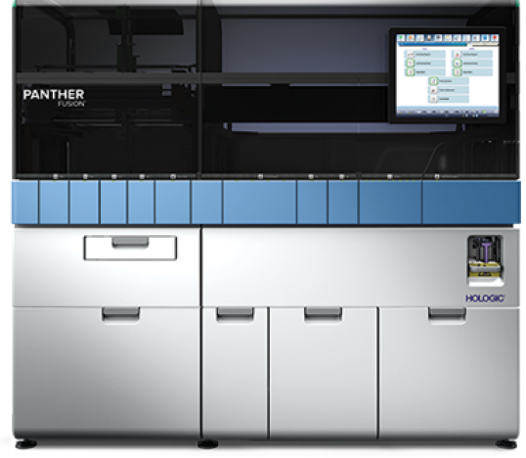
Future Projects
H5b
H7
Updated G-Block for H5b and H7
Addition of Treponema pallidum (Syphilis) to HSV1/2 & VZV Multiplex Assay
  N ew G-block control Design
  Re-optimization of Primers/Probes
https://www.hologic.com/hologic-products/diagnostic-solutions/panther-scalable-solutions

Slide 16
APHL Fellow Poster
Influenza A Subtyping
Digital Poster ID: D3052
Presentation/Questions: Tuesday at 6:15pm – 6:30pm

Slide 17
Questions?
Whitney Platte BS
Clinical Lab Analyst
State Hygienic Lab at the University of Iowa
319-335-4376
whitney-koppes@uiowa.edu
Maree Elliott MPH
APHL Fellow
State Hygienic Lab at the University of Iowa
maree-elliott@uiowa.edu
Kris Eveland MB(ASCP)^{CM}
Clinical Lab Technical Specialist
State Hygienic Lab at the University of Iowa
319-335-4279
Kristofer-Eveland@uiowa.edu
uiowa.edu

Slide 18
Acknowledgments
Maree Elliott MPH, APHL Fellow
Jeff Benfer MS MB(ASCP)^{CM} Molecular Department Supervisor
Kris Eveland MB(ASCP)^{CM}
Entire Hologic Team

Slide 19
Thank you
Whitney Platte BS
Clinical Laboratory Analyst
Molecular Department
319-335-4376
whitney-koppes@uiowa.edu
uiowa.edu

Slide 20
Closing Slide Header

